Slide 1
Selenium Training
LEVEL – LEARNER

Slide 2








Icon Used
Hands on Exercise
Reference
Questions
Points To Ponder
Coding Standards
Lend A Hand
Summary
Test Your Understanding

Slide 3

Objective
After completing this session, we will be able to :
Describe Selenium and its purpose
Understand Selenium IDE
Explain JUNIT
Explain Locators
Explain Selenium RC
Explain TestNG and ReportNG

Slide 4
Test Automation
Its a much talked about topic in the world of software testing and quality.
Its a process of writing a computer program to do testing which needs to be done manually.
Simply its automating the manual testing process currently in use.

Slide 5
Advantages and Limitations
Advantages
Less time consumption
Reliable
Reusable
Better Quality Software
Fast
Cost effective – Only in longer term projects
Limitations
Expensive
Proficiency
Debugging
Maintenance

Slide 6
Different Automation Tools
QTP - HP
IBM Rational - IBM
Rational Robot - IBM
Selenium – Open Source
Test Professional –MS
WATIR – Open Source
WebUI Test Studio – Telerik
Test Partner – Micro Focus
Silk Test – Micro Focus
Ranorex - Ranorex GmbH
HTTP Test tool – Open Source
Test Complete - SmartBear

Slide 7
Why Selenium
Open Source
Record and Playback
Supports multi domain languages
Supports different platforms
Cost saving

Slide 8
Selenium History
Developed by Jason Huggins at ThoughtWorks in 2004
First he came up with a Server which executes test scripts – Remote Control
In 2006, Shinya Kasatani from Japan developed a Firefox plugin – IDE
In 2007, Jason joined Selenium support team in Google and developed Grid.

Slide 9
Components of Selenium
Selenium IDE
Selenium RC
Selenium Grid

Slide 10
Selenium IDE
Selenium IDE is a Firefox add-on developed originally by Shinya Kasatani
It has been developed using JavaScript so that it can interact with DOM (Document Object Model) using native JavaScript calls.
It was developed to allow testers and developers to record their actions as they follow the workflow that they need to test.

Slide 11
Installing IDE
Firefox must be installed before we proceed with Selenium IDE
IDE can be downloaded in the selenium site http://seleniumhq.org/download/
Selenium IDE 1.0.12 is the latest version
Once its installed, it will available in the Tools menu in Mozilla Firefox

Slide 12
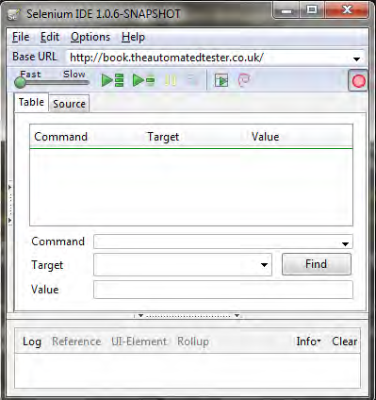
Selenium IDE icons

Slide 13
Recording and running Tests
1. Change the Base URL of the application under test. In this exercise, we will do it against http://book.theautomatedtester.co.uk/.
2. Click on the radio button.
3. Change the value of the Select.
4. Click on the link.
5. Your test has now been recorded . Click on the play button.

Slide 14
Pop quiz – Selenium IDE
What is the main language that drives Selenium IDE?
Selenium IDE works on Internet Explorer. TRUE or FALSE

Slide 15
Assertion and Verification
There are two mechanisms for validating elements that are available on the application under test. Assert and Verify
Assert: this allows the test to check if the element is on the page. If it is not available, then the test will stop on the step that failed.
Verify: this also allows the test to check whether the element is on the page, but if it isn't, then the test will carry on executing.

Slide 16
How to use Assert and Verify
To add the assert or verify to the tests, we need to use the context menu that Selenium IDE adds to Firefox.
All that one needs to do is right-click on the element , then you will need to do the two-finger click to display the Context menu

Slide 17
Exercise
1. Open the IDE so that we can start recording.
2. Set the Base URL to http://book.theautomatedtester.co.uk/.
3. Click on Chapter1.
4. Click on the radio button.
5. Change the select to Selenium Grid.
6. Verify that the text on the right-hand side of the page has Assert that this text is on the page.
7. Verify that the button is on the page. You will need to use the context menu for this.

Slide 18
Assert and Verify commands
assertElementPresent
assertElementNotPresent
assertText
assertChecked
assertAlert
assertTitle
verifyElementPresent
verifyElementNotPresent
verifyText
verifyChecked
verifyAlert
verifyTitle

Slide 19
Handling Multiple Windows
Web applications unfortunately do not live in a single window of your browser.
Working with multiple browser windows can be one of the most difficult things to do within a Selenium test.
But, still its possible.

Slide 20
Different commands for handling multiple windows
waitForPopUp - It will ask Selenium to wait for a web server to handle the request and the browser to render the page.
selectWindow – It tells Selenium IDE that it will need to switch context to the window called popupwindow and will execute all the commands that follow in that window
windowFocus – It tells Selenium IDE to focus the popupwindow which currently selected.

Slide 21
Exercise for single popup
Open up the Selenium IDE and go to the Chapter1 page on the site.
Click on one of the elements on the page that has the text Click this link to launch another window. This will cause a small window to appear.
Once the window has loaded, click on the Close the window text inside it.
Add a verify command for an element on the page.
Click on the Close the window link.
Verify the element on the original window.

Slide 22
Exercise for multiple popup
Start the Selenium IDE and go to Chapter1 on the website.
Click on the first link that will launch a pop-up window.
Assert the text on the page.
Go back to the parent window and click on the link to launch the second pop-up window.
Verify the text on the page.
Move to the first pop-up window and close it using the close link.
Move to the second pop-up window and close it using the close link.
Move back to the parent window and verify an element on that page.
Run your test and watch how it moves between the windows.

Slide 23
Ajax pages
Web applications today are being designed in such a way that they appear the same as desktop applications. Web developers are accomplishing this by using AJAX within their web applications.
AJAX stands for Asynchronous JavaScript and XML due to the fact that it relies on JavaScript for creating asynchronous calls and then returning XML with the data that the user or application requires in order to carry on.
AJAX does not rely on XML anymore, as more and more people move over to JavaScript Object Notation (JSON), which is more lightweight in the way that it transfers the data.

Slide 24
AJAX Commands
waitForAlertNotPresent
waitForAlertPresent
waitForElementPresent
waitForElementNotPresent
waitForTextPresent
waitForTextNotPresent
waitForPageToLoad
waitForFrameToLoad

Slide 25
Test Suites and Test Cases
Test Suites – Collection of test cases. We can create a single test suite and add number of test cases into it. All test cases can be executed simultaneously by running the entire test suite.
Test Case – Test case is a single script which covers a specific functionality of the web page.

Slide 26
Test Suites and Test Cases
Creating Test Suite
Adding test cases
Saving the test cases
Saving the test suite
Executing test case one by one
Executing the entire test suite

Slide 27
Things we can’t record using IDE
Silverlight and Flex/Flash applications cannot be recorded with Selenium IDE as they does not follow DOM
HTML5 is not fully supported with Selenium IDE
Selenium IDE does not work with Canvas elements on the page either, so you will not be able to make your tests move items around on a page.
Selenium cannot do file uploads. This is due to the JavaScript sandbox not allowing JavaScript to interact with <input type=file> elements on a page.

Slide 28
Locators
Locators allow us to find elements on a page that can be used in our tests. Find the different ways of locating elements on the page.
Locate elements by ID
Locate elements by name
Locate elements by link
Locate elements by Xpath
Locate elements by CSS

Slide 29
Locating elements by ID
Click on the Firebug icon. This is the bug icon on the bottom of Firefox.
Click on the icon to the left-hand side of Console .
Move your mouse over the element that you wish to have a look at.
Move your mouse over different elements. Firebug will highlight each of the items that you want to see.
Find an element that you want to interact with and in the Target box place its ID attribute value.

Slide 30
Locating elements by name
Click on the Firebug icon. This is the bug icon on the bottom of Firefox.
Click on the icon to the left-hand side of Console .
Move your mouse over the element that you wish to have a look at.
Move your mouse over different elements. Firebug will highlight each of the items that you want to see.
Find an element that you want to interact with and in the Target box place its name attribute value.

Slide 31
Locating elements by link
Click on the Firebug icon. This is the bug icon on the bottom of Firefox.
Click on the icon to the left-hand side of Console .
Move your mouse over the element that you wish to have a look at.
Move your mouse over different elements. Firebug will highlight each of the items that you want to see.
Find an element that you want to interact with and in the Target box place its link attribute value.

Slide 32
Locating elements by XPath
Xpath can be identified with the help of Xpather plug-in
Once the plug-in installed, right click on any element, click on Show in Xpather.
Xpath can be used when we don’t have ID or name for the elements

Slide 33
Locating elements by CSS Path
CSS path can be identified with the help of firebug

Slide 34
Selenium RC – Remote Control
What is Selenium Remote Control
Setting up Selenium Remote Control
Running Selenium IDE tests with Selenium RC
Selenium RC arguments
Selenium Remote Control has been written in Java to allow it to be cross platform, so we can test on Mac, Linux, and Windows. Make sure you have Java installed on your computer.

Slide 35
What is Selenium Remote Control
Its a test tool that allows you to write automated web application UI tests in any programming language against any HTTP website using any mainstream JavaScript-enabled browser.
Selenium RC comes in two parts.
A server which automatically launches and kills browsers, and acts as a HTTP proxy for web requests from them.
Client libraries for your favorite computer language.
Selenium Remote Control is great for testing complex AJAX-based web user interfaces under a Continuous Integration system. It is also an ideal solution for users of Selenium IDE who want to write tests in a more expressive programming language than the Selenese HTML table format.

Slide 36
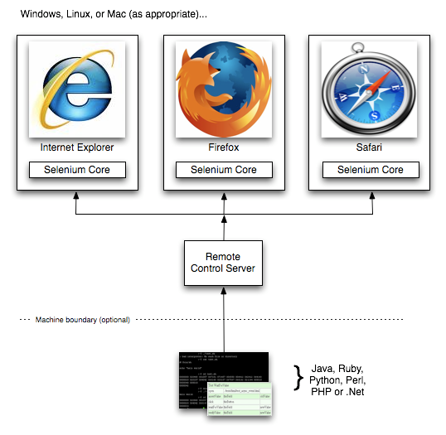
How Selenium RC Works

Slide 37
Setting up Selenium Remote Control
Download Selenium Remote Control from http://seleniumhq.org/download.
Extract the ZIP file.
Start a Command Prompt or a console window and navigate to where the ZIP file was extracted.
Run the command java –jar selenium-server-standalone.jar

Slide 38
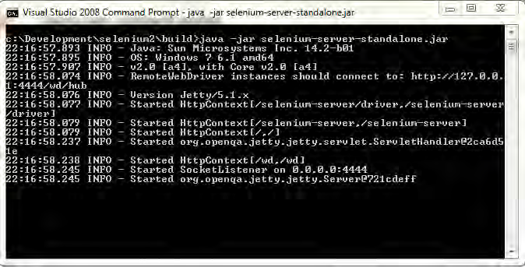
Setting up Selenium Remote Control

Slide 39
Setting up Selenium Remote Control
We have successfully set up Selenium Remote Control. This is the proxy that our tests will communicate with.
It works by language bindings, sending commands through to Selenium Remote Control which it then passes through to the relevant browser.

Slide 40
Running Selenium IDE tests with Selenium Remote Control
Imagine that you have to run your Selenium IDE tests on a computer that doesn't have Selenium IDE installed or you do not want to use Firefox with any add-ons installed
To run our tests in Selenium Remote Control we will have to use the –htmlsuite argument. This tells Selenium to open the Test Suite that we created
We then need to tell it where to find the Test Suite and then where to write the results to.
Our command in Command Prompt or a console window will be similar to the following snippet:
Java –jar selenium-server-standalone.jar –htmlsuite *firefox http://book. theautomatedtester.co.uk c:\path\to\testsuite.html c:\path\to\result.html

Slide 41
Running your Selenium IDE tests in Internet Explorer
Internet Explorer is one of the most popular browsers among users. Internet Explorer comes bundled with Microsoft operating systems, which is found on almost 90% of computers in the world.
We, as developers and testers, should always be making sure that our code works on at least the latest variation of Internet Explorer
java –jar selenium-server.jar –htmlsuite *iexplore http://book.theautomatedtester.co.uk c:\path\to\ testsuite.html c:\path\to\result.html

Slide 42
Running your Selenium IDE tests in other browsers
Google Chrome - java –jar selenium-server.jar –htmlsuite *googlechrome http://book.theautomatedtester.co.uk c:\path\ to\testsuite.html c:\path\to\result.html
Safari - java –jar selenium-server.jar –htmlsuite *safari http://book.theautomatedtester.co.uk c:\path\ to\testsuite.html c:\path\to\result.html
Opera - java –jar selenium-server.jar –htmlsuite *opera http://book.theautomatedtester.co.uk c:\path\ to\testsuite.html c:\path\to\result.html

Slide 43
What is Eclipse
Eclipse is probably best known as a Java IDE
Basically its a platform that has been designed for building integrated web and application development tooling
It provides a common user interface (UI) model for working with tools.
It can be also used for unit testing and test automation. We can prepare our unit test scripts and automation test scripts and run it from here.
It supports lot of testing frameworks like Junit, TestNG, ReportNG and FitNesse
Eclipse can be downloaded here, its an open source www.eclipse.org/downloads/

Slide 44
Configuring Selenium RC with Eclipse
Open Eclipse – Project Explorer
Click on New Project – Name that Project
Right click on that Project – Select Properties
On the Properties window, add your selenium remote control library files (jar files)
Also add Junit library file for executing your selenium tests.
Click on OK and close the Properties window
Add a Java Class in your Project and write your coding.
Execute your Java Class with the help of Junit.

Slide 45
Creating sample tests using RC
Import your selenium package
Import your Junit package
Inherit SeleneseTestBase Class in your class
Create a test method (Test Execution will be started from here)
Create an object for DefaultSelenium class and add your parameters
Start your selenium server and perform testing by writing your code
Stop the selenium server

Slide 46
Creating sample tests using RC
import com.thoughtworks.selenium.*;
import org.junit.*;
public class firstClass extends SeleneseTestBase {
@Test
public void firstMethod()
{
selenium = new DefaultSelenium("localhost", 4444, "*chrome", "http://www.google.co.in");
selenium.start();
selenium.open("/");
System.out.println(selenium.getTitle());
selenium.close();
selenium.stop();
}
}

Slide 47
Converting IDE tests to Java code(RC)
Our Selenium IDE tests can be converted into our familiar language format
Record some tests in IDE, goto Options menu and click on Format
You will find a list of language with framework
Select your favorite language and you will get a set of code
Copy that code and paste it in your language editor and run it

Slide 48
What is JUnit
JUnit is a unit testing framework for the Java programming language.
A JUnit Test fixture inherits from junit.framework.TestCase.
It has lot of test annotations like @Test, @Before, @After and etc
Test methods must be annotated by the @Test annotation
It is also possible to define a method to execute before (or after) each (or all) of the test methods with the @Before (or @After) and @BeforeClass (or @AfterClass) annotations.

Slide 49
JUnit Syntax
import junit.framework.TestCase;
import org.junit.*;
public class TestFoobar extends TestCase{
@BeforeClass
public static void setUpClass() throws Exception {
// Code executed before the first test method
}
@AfterClass
public static void tearDownClass() throws Exception {
// Code executed after the last test method
}

Slide 50
JUnit Syntax(contd.)
@Before
public void setUp() throws Exception {
// Code executed before each test
}
@After
public void tearDown() throws Exception {
// Code executed after each test
}
@Test
public void test() {
assertTrue(true);
}
}

Slide 51
Creating Selenium instance with JUnit
import com.thoughtworks.selenium.*;
import org.junit.*;
public class firstClass extends SeleneseTestBase {
@Before
public void setup() {
selenium = new DefaultSelenium("localhost", 4444, "*chrome", "http://www.google.co.in");
selenium.start();
}
@Test
public void firstMethod() {
selenium.open("/");
System.out.println(selenium.getTitle());
}

Slide 52
Creating Selenium instance with Junit(contd.)
@Test
public void secondMethod() {
selenium.open("/");
selenium.click("id=gbi4s1");
selenium.waitForPageToLoad("10000");
System.out.println(selenium.getTitle());
}
@After
public void tearDown()
{
selenium.close();
selenium.stop();
}
}

Slide 53
Running Junit Tests
When you run your test for the first time, right click on that and check if you have Junit Test in the list
Otherwise, go to Run Configurations, select Junit Test as your Run Option
Once its done, you will get the Junit Test option in the Run As list.
When you select that option, you will be switched to Junit Runner where you can find your test classes and methods

Slide 54
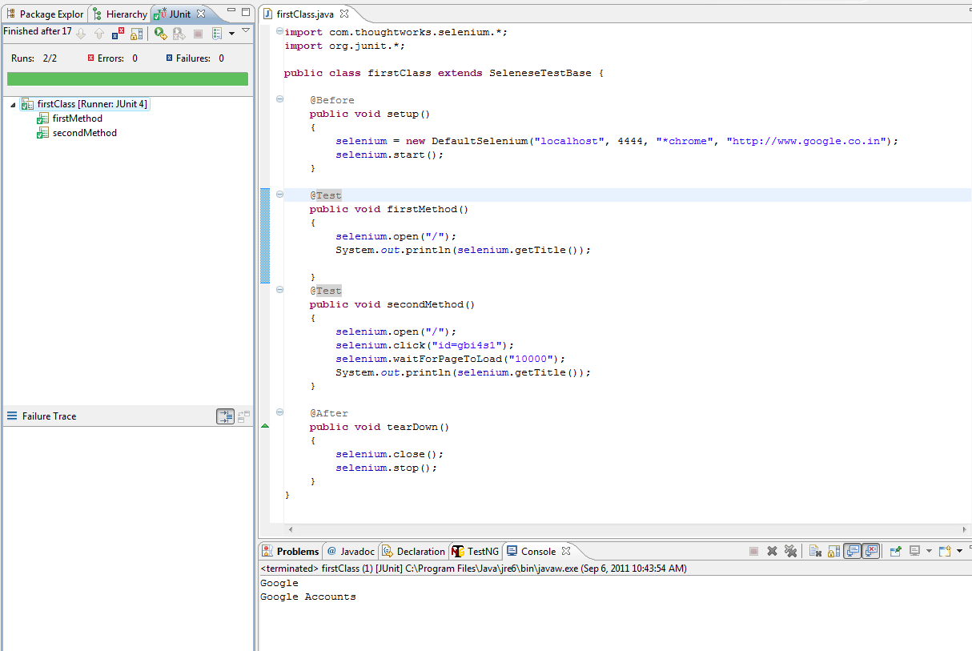
Running Junit Tests

Slide 55
Creating Test Suites in JUnit
We can create Test Suites in JUnit and include our classes into it.
Test Suites can be created with the help of following annotations
@RunWith
@Suite

Slide 56
Creating Test Suites in JUnit
import org.junit.runner.RunWith;
import org.junit.runners.Suite;
@RunWith(Suite.class)
@Suite.SuiteClasses({
GoogleCheck.class,
LoginCheck.class
})
public class MyTestSuite {
}

Slide 57
Advanced Selenium Techniques
Cookie Handling
Capture network traffic
Capture screenshot

Slide 58
Cookie Handling
Cookies are a common way to store data between pages.
We can handle these cookies using Selenium
We have some Selenium methods to handle cookies
getCookieByName()
getCookie()
deleteCookie()

Slide 59
Handling Single Cookie
@Before
public void setUp(){
selenium = new DefaultSelenium("localhost",4444,"*chrome","http://book.theautomatedtester.co.uk");
selenium.start();
}
@Test
public void ShouldGetACookie(){
selenium.open("/chapter8");
String cookie = selenium.getCookieByName("visitorCount");
System.out.println(cookie);
selenium.open("/chapter8");
cookie = selenium.getCookieByName("visitorCount");
System.out.println(cookie);
}
@After
public void tearDown() throws Exception {
selenium.stop();
}

Slide 60
Handling Multiple Cookies
@Before
public void setUp(){
selenium = new DefaultSelenium("localhost",4444,"*chrome","http://book.theautomatedtester.co.uk");
selenium.start();
}
@Test
public void shouldGetAllCookiesOnThePage(){
selenium.open("/chapter8");
selenium.click("secondCookie");
System.out.println(selenium.getCookie());
String[] cookies = selenium.getCookie().split(";");
System.out.println(cookies[0]);
System.out.println(cookies[1]);
}
@After
public void tearDown() throws Exception {
selenium.stop();
}

Slide 61
Deleting Cookies
@Before
public void setUp(){
selenium = new DefaultSelenium("localhost",4444,"*chrome","http://book.theautomatedtester.co.uk");
selenium.start();
}
@Test
public void shouldDeleteACookieOnThePage(){
selenium.open("/chapter8");
selenium.deleteCookie("visitorCount","path=/");
selenium.open("/chapter8");
String cookie = selenium.getCookieByName("visitorCount");
System.out.println(cookie);
}
@After
public void tearDown() throws Exception {
selenium.stop();
}

Slide 62
Capture Network Traffic
Nowadays Web Applications build like a Desktop applications by adding lot of AJAX requests.
Instead of getting the complete page from the server, we can send a request for getting data for some specific modules.
Hence your web applications stay stable and all your web request to server and response from server happens in the background.
If you want to track all those requests/responses, we can use capture network traffic method in Selenium

Slide 63
Capture Network Traffic
First we need to pass in a parameter captureNetworkTraffic=true when we start the browser
Then we can use captureNetworkTraffic method to track all the http request/response for the page.
This method will capture these request/response in any of these formats; plain, JSON and XML.

Slide 64
Example for Capture Network Traffic
@Before
public void setUp(){
selenium = new DefaultSelenium("localhost", 4444, "*firefox", "http://original.aol.com/");
selenium.start("captureNetworkTraffic=true");
}
@Test
public void captureTraffic() throws Exception {
selenium.open("/");
plain = selenium.captureNetworkTraffic("plain");
System.out.println(plain);
}
@After
public void tearDown() throws Exception {
selenium.stop();
}

Slide 65
Capture Network Traffic results
Plain format
403 GET http://localhost:4444/favicon.ico
1244 bytes
0ms (2011-11-22T11:49:57.501+0530 - 2011-11-22T11:49:57.501+0530
Request Headers
- Host => localhost:4444
- User-Agent => Mozilla/5.0 (Windows; U; Windows NT 5.1; en-GB; rv:1.9.2.24) Gecko/20111103 Firefox/3.6.24
- Accept => text/html,application/xhtml+xml,application/xml;q=0.9,*/*;q=0.8
- Accept-Language => en-gb,en;q=0.5
- Accept-Encoding => gzip,deflate
- Accept-Charset => ISO-8859-1,utf-8;q=0.7,*;q=0.7
- keep-alive => 115
- Proxy-Connection => keep-alive
Response Headers
- Date => Tue, 22 Nov 2011 06:19:57 GMT
- Server => Jetty/5.1.x (Windows XP/5.1 x86 java/1.6.0_29
- Content-Type => text/html
- Content-Length => 1244
- Via => 1.1 (jetty)

Slide 66
Capture Screenshots
As a developer or tester, you need a mechanism in place to have a screenshot of what the error looks like when a test fails, preferably images that are captured in the PNG format.
We have some Selenium methods to capture the screenshots.
But it works only with Firefox and Internet Explorer browsers

Slide 67
Capture Screenshots
Below are the methods available in Selenium:
captureScreenshot()
captureScreenshotToString()
captureEntirePageScreenshot ()
captureEntirePageScreenshotToString()

Slide 68
Capture Screenshots
captureScreenshot()
public void shouldTakeAScreenShot(){
selenium.open("/chapter8");
selenium.captureScreenshot(“C:\\test.png");
}
captureEntirePageScreenshot()
public void shouldTakeAScreenShotEntirePage(){
selenium.open("/chapter8");
selenium.captureEntirePageScreenshot(
C:\\test.png","");
}

Slide 69
Capture Screenshots with background color
public void shouldTakeAScreenShotEntirePage(){
selenium.open("/chapter8");
selenium.captureEntirePageScreenshot(
C:\\test.png"," background=#ccffdd");
}

Slide 70
Capture Screenshots to String
public void CaptureToString() {
selenium.open("/chapter8");
String screenshot =selenium.captureEntirePageScreenshotToString("");
System.out.println(screenshot);
}

Slide 71
TestNG
TestNG is a testing framework inspired from JUnit and NUnit but introducing some new functionalities that make it more powerful and easier to use.
TestNG is designed to cover all categories of tests: unit, functional, end-to-end, integration, etc.
Its an open source and released with Apache License 2.0
Refer this site for more details:
http://testng.org/doc/index.html

Slide 72
TestNG Setup
First we need to install TestNG plugin for Eclipse.
Go to Help – Install New Software – Click Add
In Add Repository box, type TestNG and type the URL http://beust.com/eclipse
TestNG plugin will added into Available Software List.
Click on Next and follow the installation screen to complete the setup
Restart Eclipse and go to Run menu and open Run Configurations
Check if you have TestNG option listed there.

Slide 73
TestNG Setup - Continues
Download TestNG jar file from this URL http://testng.org/doc/download.html
Once its downloaded, goto Project Properties and add that jar file in your class path
Now create a new class, import the necessary packages, use the testng annotations and create your test methods
Once the class is ready to run, right click on it choose Run As – TestNG Test

Slide 74
TestNG – Run Options
While Running your tests, it provides the below list of options.
Class
Method
Group
Package
Suite
It also gives an option of creating test suites, place it in the XML file and run the XML.

Slide 75
TestNG – Run Options – Group Test
We can create groups in TestNG and configure test methods from different classes/packages.
When we execute that group, the methods whichever configured with the group will be executed.
Please follow the below syntax to create group
@Test (groups = { “<group name>" })
This group can be executed from Run Configurations window.

Slide 76
TestNG - Group Test Example
@Test (groups = { "High" })
public void testWindow2() throws Exception {
selenium.open("/");
selenium.type("id=lst-ib", "sachin");
selenium.click("name=btnG");
Thread.sleep(5000);
selenium.click("link=Sachin Tendulkar - Wikipedia, the free encyclopedia");
selenium.waitForPageToLoad("30000");
verifyTrue(selenium.isTextPresent("Sachin Tendulkar"));
}
Make sure you make setup() and teardown() methods always run while going for Group Test.
@BeforeMethod (alwaysRun = true)
public void setUp() throws Exception {
selenium = new DefaultSelenium("localhost", 4444, "*chrome", "http://www.google.co.in/");
selenium.start();
}

Slide 77
TestNG – Dependency Test
It means methods will be tested base on dependency, which will execute before a desired method.
If the dependent method fails, then all subsequent tests will be skipped, not marked as failed.
We need to use “dependOnMethods “ to implement the dependency testing in TestNG

Slide 78
TestNG – Dependency Test
@Test
public void method1() {
System.out.println("This is method 1");
}
@Test (dependsOnMethods={"method1"})
public void method2() {
System.out.println("This is method 2");
}

Slide 79
TestNG – Ignore Test
The “Ignored” means whether it should ignore the unit test during the execution.
Check the syntax below:
@Test(enabled=false)
public void divisionWithException()
{
System.out.println("Method is not ready yet");
}

Slide 80
TestNG – Exception Test
It means what exception throw from the unit test during the execution.
Check the syntax below:
@Test(expectedExceptions = ArithmeticException.class)
public void divisionWithException()
{
int i = 1/0;
}

Slide 81
TestNG – Timeout Test
It means if an unit test takes longer than the specified number of milliseconds to run, the test will terminated and mark as fails.
Check the syntax below:
@Test(timeOut = 1000)
public void infinity() {
while (true);
}

Slide 82
TestNG – Parameterized Test
It means passing parameter values to unit test.
We have two ways of passing parameters:
Data Providers
XML (TestNG.xml)
XML parameter method is quite simple to use.
But if we need to pass more number of parameters we need to think about Java concepts like JXL and Database (JDBC)

Slide 83
TestNG – Parameterized Test – XML
TestNG XML
<suite name="My test suite">
<test name="testing">
<parameter name=“username" value=“selenium_user"/>
<classes> <class name=“TestNGTest" />
</classes>
</test>
</suite>
We need to use “@Parameter” annotation in our test definitions.
public class TestNGTest {
@Test
@Parameters(value=“username")
public void LoginCheck(Stringusername) {
Selenium.type(“id=uname”,username) }
}

Slide 84
TestNG – Reports
TestNG provides a default reporting option.
Once the test has executed, go to the Project, check if you have test-output folder.
Inside that folder, open emailable-report.html
It gives you the default report captured while executing your tests.
We can go for Advanced Reporting like ReportNG or XSLT reports. Refer this URL for details http://code.google.com/p/testng-xslt/

Slide 85
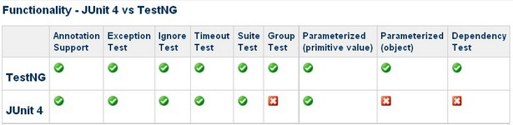
TestNG Vs JUnit

Slide 86
ReportNG
Its an alternative HTML reporting plug-in for TestNG.
Generates easy-to-understand HTML reports.
Download ReportNG jar file from the location http://reportng.uncommons.org/
Once its downloaded, include the below files in your classpath
Reportng jar
Velocity jar

Slide 87
ReportNG
There’s a default listener in TestNG which will capture the output and prepare report.
We have to disable that default listener and make ReportNG listener active.
Go to Project Properties – TestNG – Disable default listeners.
Also, include the code (Next slide) to activate ReportNG report listener.

Slide 88
ReportNG
<testng>
useDefaultListeners="false"
</testng>
<listeners>
<listener class-name="org.uncommons.reportng.HTMLReporter" /> <listener class-name="org.uncommons.reportng.JUnitXMLReporter" />
</listeners>

Slide 89
Selenium Grid
It’s a component of Selenium designed to execute parallel tests.
Selenium Grid has two components: Selenium Hub and Remote Control.
The hub receives requests from tests (the same as Selenium RC), and then allocates remote controls that are registered to the hub to each test.

Slide 90
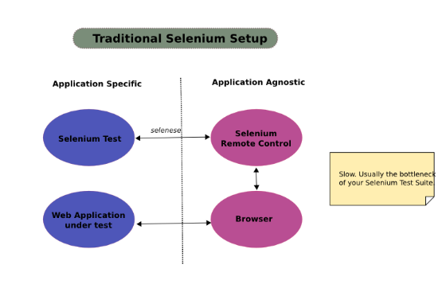
How Selenium RC works

Slide 91
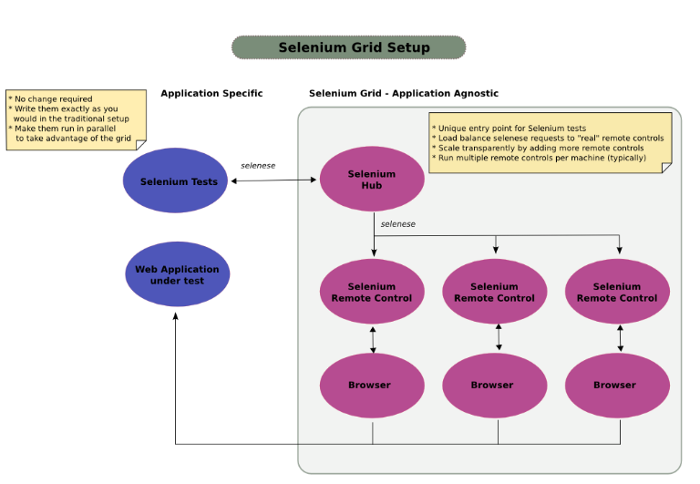
How Selenium Grid works

Slide 92
Selenium Grid Setup
Download Selenium Grid from the following location: http://selenium-grid.seleniumhq.org/download.html
Make sure you have ANT installed on your computer.
ANT is a build tool which is required for starting Selenium Hub and Selenium RC
Download Apace ANT from here: http://ant.apache.org/bindownload.cgi

Slide 93
ANT Setup
Right click My Computer icon
Choose properties
Choose Advanced Tab
Choose Environment Variables Button
In the System Variables, click New Button Give the Variable Name:ANT_HOME Give the Value: C:\Ant
Click OK Then,we’ll add new ANT_HOME path
Find PATH in the Variable Column in System variables frame
After found, click Edit button
Then, add the following text in the bottom of Variable value %ANT_HOME%\bin;
Click OK to finish
Check whether ANT works correctly or not by typing ANT cmd.

Slide 94
Parallel Test using Selenium Grid
First we need to start the hub -> Type ant launch-hub command from Grid folder
Check the hub status here http://localhost:4444/console
Then start Selenium RC sessions from Grid folder:
ant -Denvironment="*firefox" -Dport=5009 -Dhost=192.168.200.50 -DhubURL=http://192.168.200.50:4444 launch-remote-control
ant -Denvironment="*iexplore" -Dport=6009 -Dhost=192.168.200.50 -DhubURL=http://192.168.200.50:4444 launch-remote-control
Two RC sessions will be started. Check the hub status again using the above URL.
Now you have Selenium Hub is ready with two RC sessions

Slide 95
Parallel Test using TestNG
Create your test classes using TestNG framework
We can go for parallel execution with different methods in TestNG XML.
Tests
Classes
Methods
Instance
Create your Test Suite using any of these option and execute your TestNG XML. Your test scripts will be executed parallely.

Slide 96
TestNG XML – Parallel Tests
<?xml version="1.0" encoding="UTF-8"?>
<!DOCTYPE suite SYSTEM "http://testng.org/testng-1.0.dtd">
<suite name="My Suite" parallel="tests">
<test name="FF Test1" preserve-order=“false">
<classes>
<class name="GoogleCheck"/>
</classes>
</test>
<test name="FF Test2" preserve-order="true">
<classes>
<class name="LoginCheck"/>
</classes>
</test>
</suite>

Slide 97
TestNG XML – Parallel Classes
<?xml version="1.0" encoding="UTF-8"?>
<!DOCTYPE suite SYSTEM "http://testng.org/testng-1.0.dtd">
<suite name="My Suite" parallel=“classes”>
<test name="My Test" preserve-order="false">
<classes>
<class name="GoogleCheck"/>
<class name="LoginCheck"/>
</classes>
</test>
</suite>

Slide 98
TestNG XML – Parallel Methods
<?xml version="1.0" encoding="UTF-8"?>
<!DOCTYPE suite SYSTEM "http://testng.org/testng-1.0.dtd">
<suite name="My Suite" parallel="methods">
<test name="My Test" preserve-order="true">
<classes>
<class name="GoogleCheck" >
<methods>
<include name="testWindow1"/>
<include name="testWindow2"/>
</methods>
</class>
</classes>
</test>
</suite>

Slide 99
FitNesse
A simple tool that allows non-technical users to specify and run acceptance tests for software systems.
We can use this tool as a framework for Selenium and execute our test scripts from here.
It supports passing parameters, specifying the expected outcome and comparing that with actual outcome.
It also provides effective reports.

Slide 100
FitNesse setup
Download FitNesse from here: http://fitnesse.org/FrontPage.FitNesseDevelopment.DownLoad
Once its downloaded, save it C:\FitNesse folder
Go to cmd prompt and type this command C:\FitNesse>java –jar fitnesse.jar
It will create some folders in the FitNesse folder.
When you type the same command again, it will start the FitNesse server.
Once FitNesse server has started, go to http://localhost
You can find the FitNesse environment.

Slide 101
FitNesse – Selenium setup
For this setup, you need to include fitnesse.jar file in your Project classpath.
Also, you need to extend ColumnFixture class instead of SeleniumTestBase
You don’t need to include any annotations here
Also we can’t use Assert/Verify commands to check if a test has passed/failed
We need to use return statements to send results.

Slide 102
FitNesse – Selenium setup
Create a folder called “lib” in your FitNesse – FitNessRoot – files folder and include all the necessary jar files.
Also, create the folder called “classes” and include all your test scripts (.class) files in this folder
Now open the FitNesse environment and add your FitNesse classpath along with your contents
!path C:\Fitnesse\FitNesseRoot\files\classes
!path C:\Fitnesse\lib\*.jar

Slide 103
FitNesse – Selenium setup
Now create your FitNesse Project and Test Suites
Include all your Test Scripts inside the Test Suite. Use the below format:
!|package name.class name|
|parameter name|method name|
|parameter value|Expected Outcome|
Execute the Test Suites by clicking on Test.

Slide 104
FitNesse – Reports
Click on Test History on the left navigation
It shows Suite wise report or Test wise report
Also, it has Day wise or Month wise report
It has report comparison option. We can compare day wise reports and it gives Score value after the comparison.

Slide 105
Questions

Slide 106
You have successfully completed –
Selenium Training

Slide 107
Change Log
Version Number | Changes made
V1.0 | Initial Version
V1.1 | Slide No. | Changed By | Effective Date | Changes Effected

